Slide 1

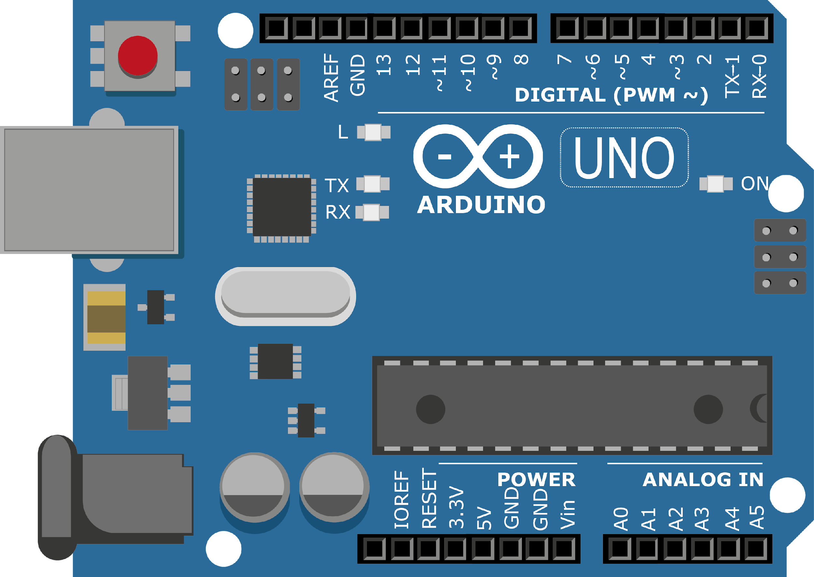
ARDUINO MASTER CLASS
17
Water level detection & alert system – SPI Protocol

Slide 2
17 AGENDA
02
03
01
SPI Protocol
Overview obout Sensor
Water level measurement

Slide 3
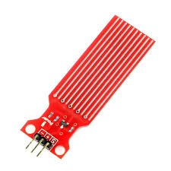
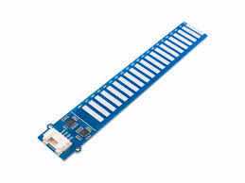
Water level sensor
Water sensor water level sensor is an easy-to-use, cost-effective high level/drop recognition sensor
Operating voltage: Dc3-5v, operating current: Less than 20ma, sensor type: Analog

Slide 4
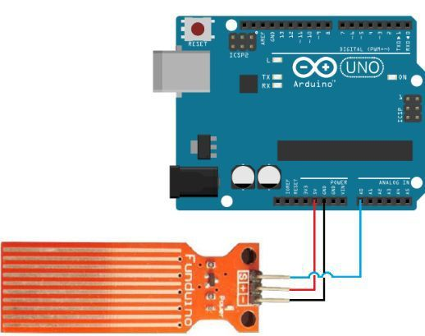
Water level sensor with Arduino – Analog I/O

Slide 5
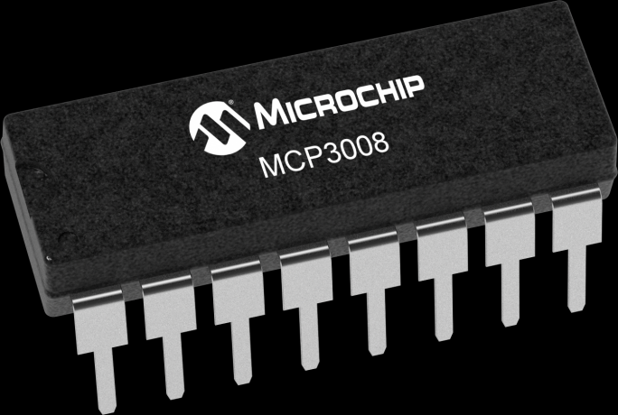
MCP3008 – External ADC IC | SPI Protocol
The MCP3008 10-bit Analog-to-Digital Converter (ADC) combines high performance and low power consumption in a small package, making it ideal for embedded control applications.
10-bit resolution
Eight single-ended channels
SPI interface
±1 LSB DNL
±1 LSB INL
200 ksps sample rate at 5V
-40 to +85°C temperature range
AEC-Q100 Grade 3

Slide 6
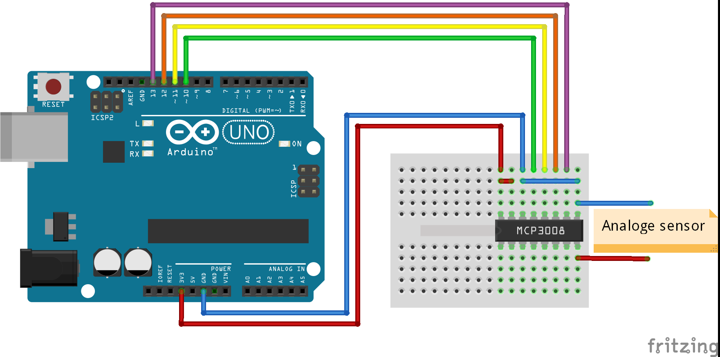
Water level sensor with Arduino via MCP3008 (Optional)

Slide 7
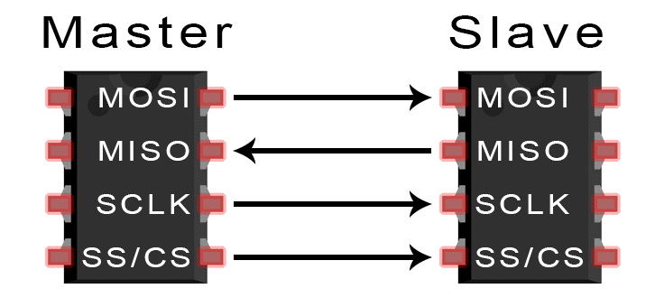
SPI Protocol
One unique benefit of SPI is the fact that data can be transferred without interruption. Any number of bits can be sent or received in a continuous stream. With I2C and UART, data is sent in packets, limited to a specific number of bits. Start and stop conditions define the beginning and end of each packet, so the data is interrupted during transmission.
MOSI (Master Output/Slave Input) – Line for the master to send data to the slave.
MISO (Master Input/Slave Output) – Line for the slave to send data to the master.

Slide 8

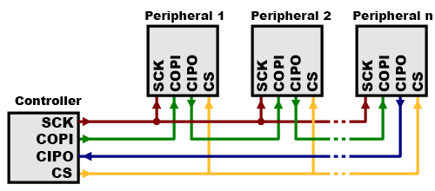
SPI Protocol
MOSI (Master Output/Slave Input) – Line for the master to send data to the slave.
MISO (Master Input/Slave Output) – Line for the slave to send data to the master.
SCLK (Clock) – Line for the clock signal.
SS/CS (Slave Select/Chip Select) – Line for the master to select which slave to send data to.

Slide 9

INTERVIEW QUESTIONS
What is ADC & DAC?
SPI Protocol?
Inductor
Serial Peripheral Interface (SPI) is an interface bus commonly used to send data between microcontrollers and small peripherals such as shift registers, sensors, and SD cards. It uses separate clock and data lines, along with a select line to choose the device you wish to talk to.
An electronic integrated circuit which transforms a signal from analog(continuous) form to digital(discrete) form is known as ADC.
To convert digital values to analog voltage DAC is used. It performs inverse operation of analog to digital converter.
An inductor is a passive electrical device employed in electrical circuits for its property of inductance. An inductor can take many forms.

Slide 10

THANKS!

